Slide 2
“The operations and maintenance costs of the Toronto LRT projects - and in particular the Eglinton project - are not a great comparison for the Hamilton LRT project.
“For example, the Eglinton LRT (called the Crosstown) is 19 km long with a 10 km underground section. As such the capital and operations costs are dramatically higher.
“Hamilton's LRT project is 11 km long and runs on the surface of the roadway only and as such a stronger comparison is the Waterloo ION LRT project.”
– Paul Johnson, Director, Hamilton LRT Office

Slide 3
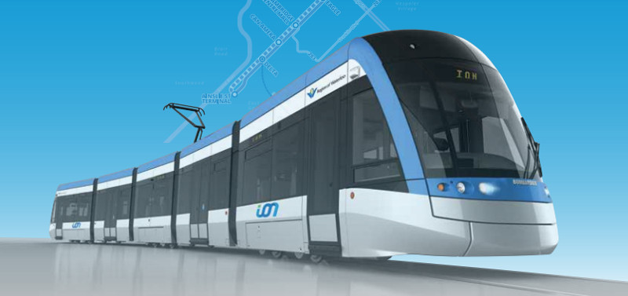
Waterloo Region ION LRT
Length: 19 km
O&M Cost: $8.5 million

Slide 4
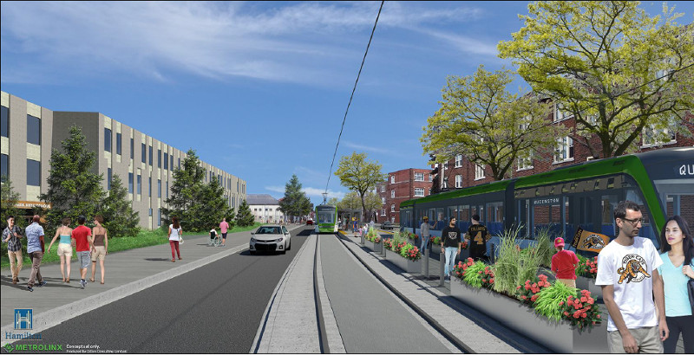
Hamilton LRT
Length: 11 km (to QTC)
Est. O&M Cost: $4.9 million

Slide 5
Hamilton LRT
Length: 14 km (to Eastgate)
Est. O&M Cost: $6.3 million

Slide 6
Hamilton B-Line Corridor Today
Route | 2015 Gross Cost | 2015 Revenue | 2015 Net Cost
01-King | $9.7 Million | $5.6 Million | $4.1 Million
05-Delaware | $13.7 Million | $5.5 Million | $8.2 Million
51-University | $4.4 Million | $2.2 Million | $2.2 Million
10-B-Line | $5.7 Million | $2.1 Million | $3.6 Million
Total | $33.5 Million | $15.3 Million | $18.2 Million

Slide 7
Cost Comparison: Express Bus vs. LRT
System | Operating Cost
LRT to Eastgate | $6.3 Million
LRT to Queenston | $4.9 Million
Current B-Line | $5.7 Million

Slide 8
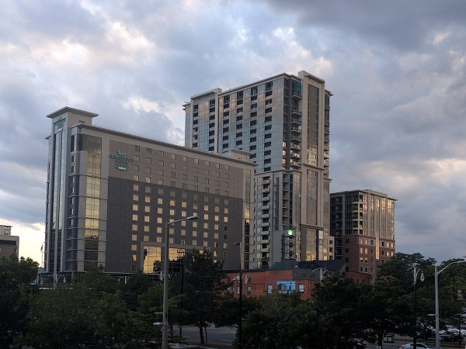
40 Bay South: $18,000 » $390,000
150 Main West: $38,000 » $510,000
Total: $56,000 » $900,000

Slide 9
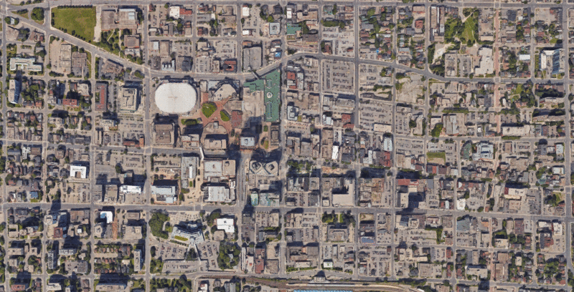
Tens of millions of dollars in new property tax assessment in just the downtown core

Slide 10
“The market being targeted by that building, he added, will appreciate the city's proposed light rail transit line.
“’Shaw went after this location because he wanted something close to the new LRT line,’ Norton said. ‘At that location you couldn't get any closer if you tried.’”
Steve Arnold, “Developer returns to Hamilton with two new projects”, The Hamilton Spectator, July 14, 2016
“The prospect of the city's light rail transit line, among other changes here, drew him to Hamilton, Kemper says.
“’Without the LRT, we wouldn't be building this building.’”
Carmela Fragomeni, “’Rental Suites’ tower planned at All Saints church site”, The Hamilton Spectator, January 24, 2017

Slide 11
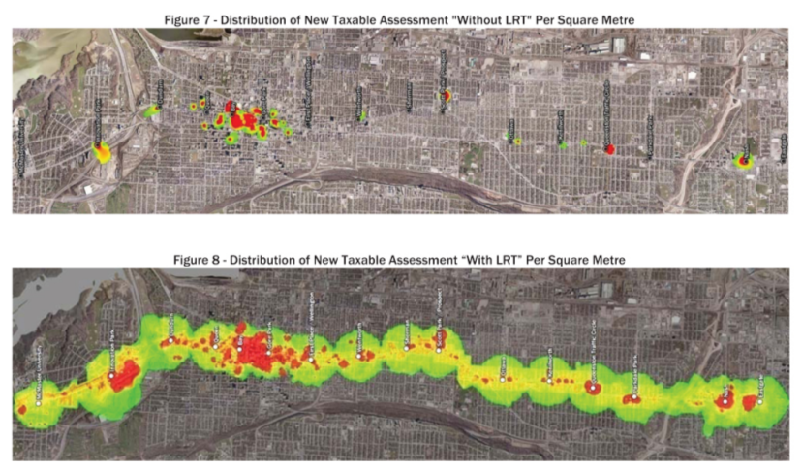
Hamilton B-Line Value Uplift and Capture Study, Canadian Urban Institute, June 2010

Slide 12
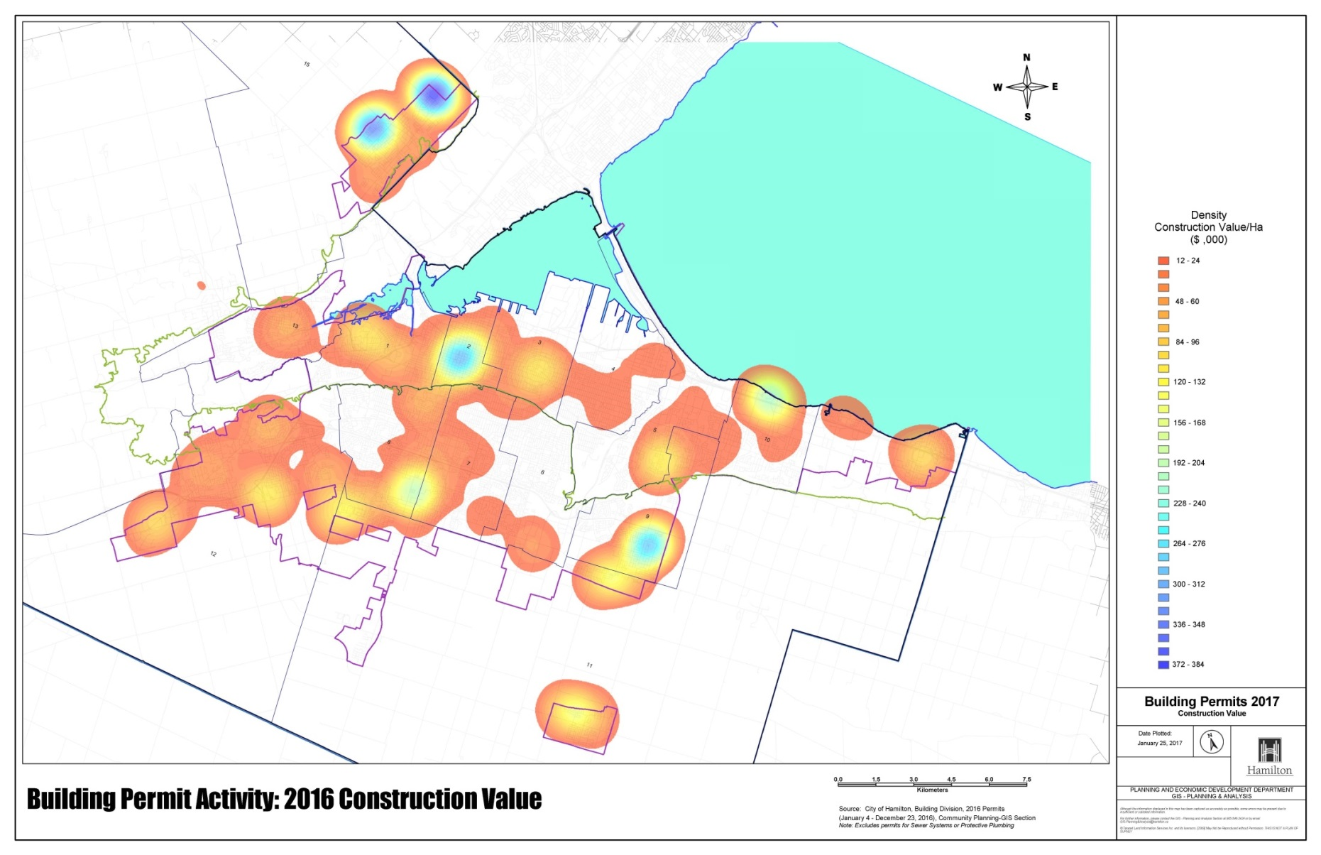
2016 Building Permit Activity by Dollar Value, Planning and Economic Development

Slide 13
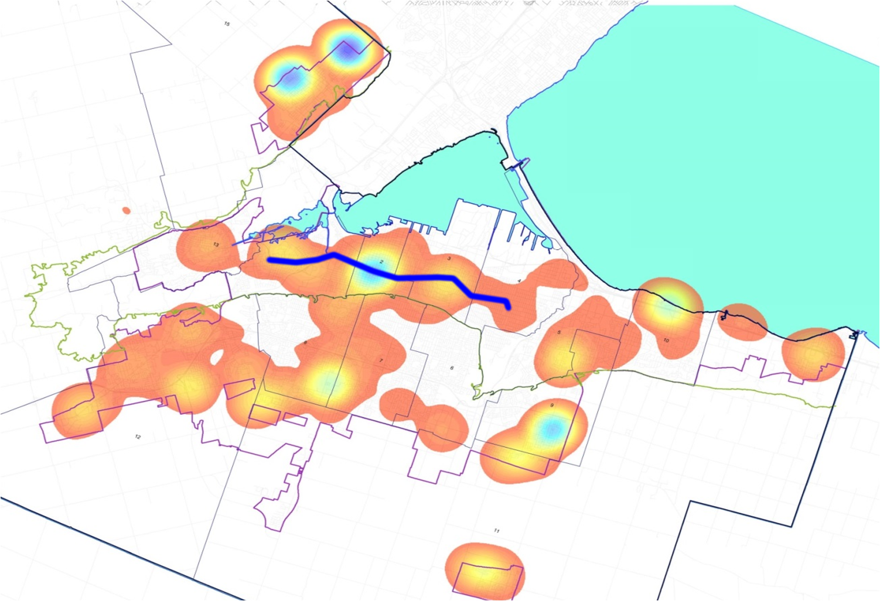
2016 Building Permit Activity by Dollar Value, Planning and Economic Development

Slide 14
“Without ION, the Region would need to build 500 new lane-km of roads over the next 20 years to accommodate expected growth.
“These new roads - the equivalent of 25 Hespeler Roads - would cost approximately $1.4 billion and would need to be built through existing neighbourhoods.”
– Waterloo Region ION LRT FAQ

Slide 15
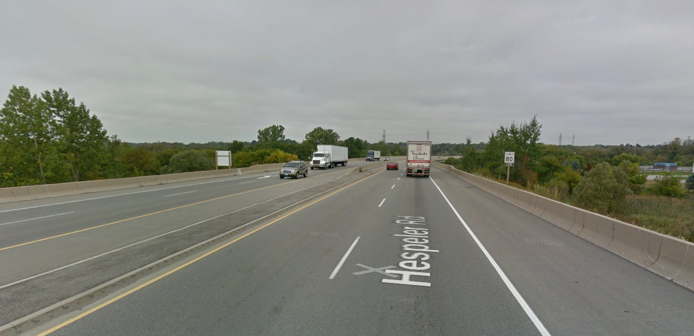
That’s 25 of these...

Slide 16
 | Hamilton | Waterloo
Population - 2011 | 520,000 | 507,096
Population - 2031 | 683,000 | 742,000
Area | 1,117 | 1,369
Urban Area | 231 | 202
Total Annual Ridership | 21,000,000 | 22,000,000
Daily Ridership - LRT Corridor | 20,000 | 20,000
Bus Fleet | 221 | 251
Total Service Hours | 650,000 | 640,000
Municipal LRT Capital Cost | $0 | $253 million
What does Hamilton know that Waterloo Region does not?

Slide 17
Tough decision?

